Slide 1
Tranz1 Intro to Design Thinking

Slide 2
Content & approach
Introduction
01
02
03
04
Discovery
Define
Develop
Delivery

Slide 3
Discover & define

Slide 4
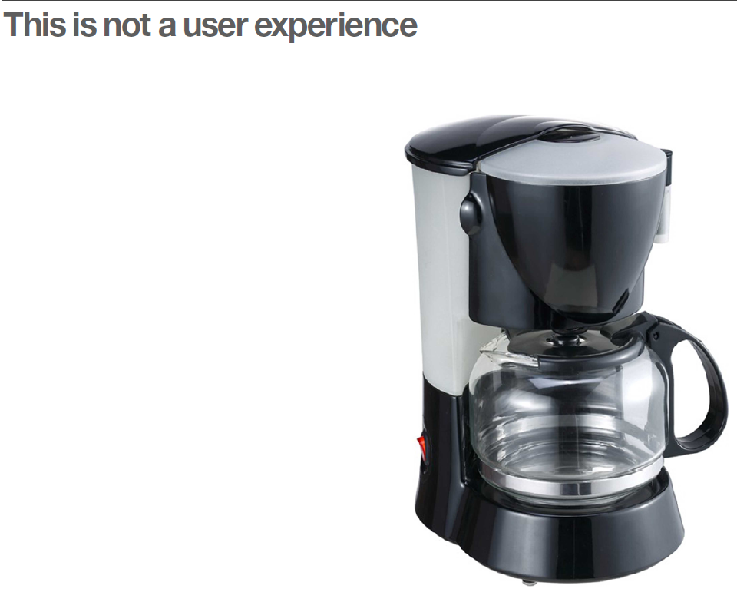

If this is our Product,
What is User experience!?

Slide 5


Slide 6
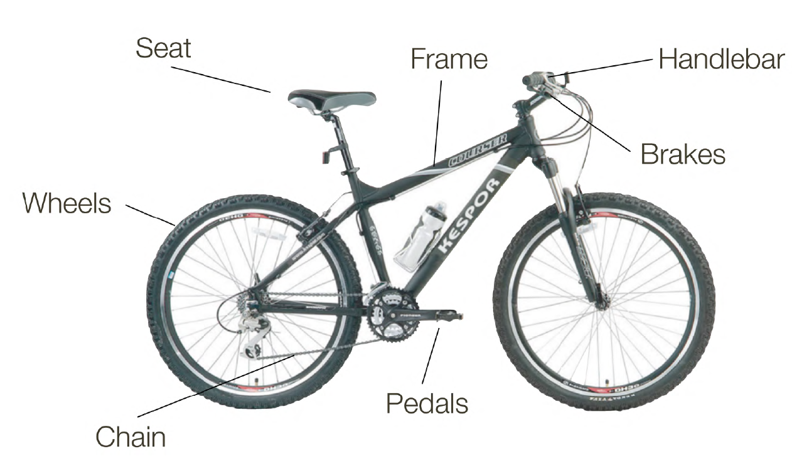
Products today!
dfine

Slide 7

What inspires us!

Slide 8

Why is this so?
define

Slide 9
Human being are powered by emotions, not reason
define

Slide 10

Converge to do right things
Define
Synthesis
Emotions
Left brain synthesis | Right Brain Reasoning
Portfolio | Experience & Events
Transactional | Relationship
Interactions | Attitude
External Data | Actions

Slide 11



How do we deliver human centered Products & services?
Explore
Explore the process of generating potential solutions for your users' problems
Evaluate
Evaluate and decide whether to move forward with an idea or generate alternate solutions
Understand
Understand and develop
empathy for users
Prototype
Prototype ideas as concrete experiences
Vision
Client Long term Strategy & Initiatives
Let’s get these training completed today! By EOD
https://www.ibm.com/design/thinking/page/courses/Practitioner
https://designsprintkit.withgoogle.com/methodology/overview

Slide 12

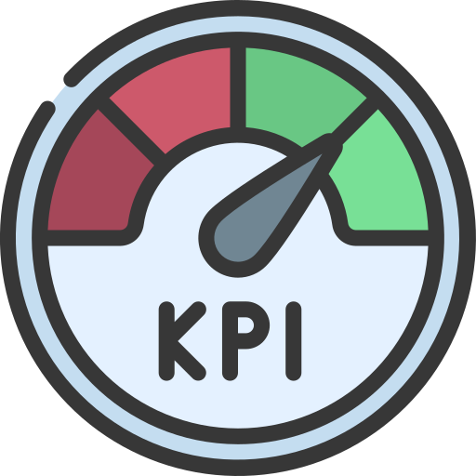









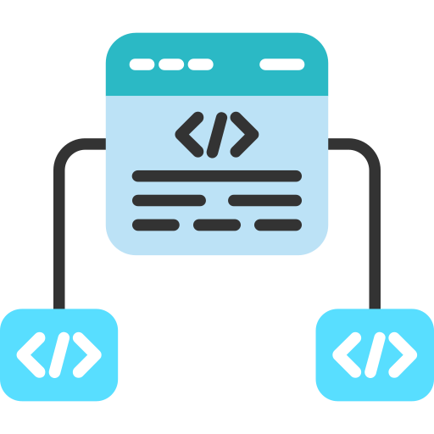

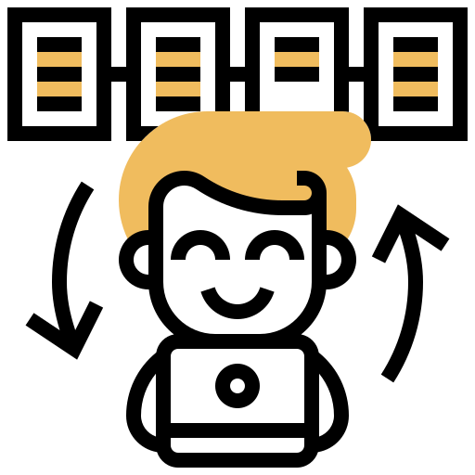
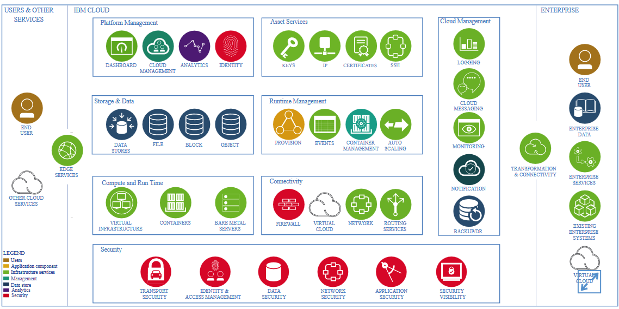
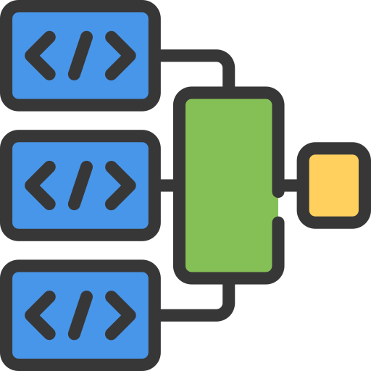


Business viewpoint
User Experience viewpoint
Data / functional Viewpoint
Implementation Viewpoint
Business model
Quantitative planning
Milestone / timeline
Story Map
User
Journey
steps
BV
UX
Data
Project
Customer
feedback
Personas
Mock-up / Wireframe
Road Map
Solution Sketch
Data Domain
API Components
AI Use cases
Backlog
E2E Architecture
Asset Integration
Software Architecture
AI Architecture

Slide 13
End Slide Layout

